Slide 1
MLA
Prof Sarika Patil

Slide 2
Supervised learning
Supervised learning as the name indicates the presence of a supervisor as a teacher.
Basically supervised learning is a learning in which we teach or train the machine using data which is well labeled that means some data is already tagged with the correct answer
After that, the machine is provided with a new set of examples(data) so that supervised learning algorithm analyses the training data(set of training examples) and produces a correct outcome from labeled data.

Slide 3
E.g Suppose you are given a basket filled with different kinds of fruits.
Now the first step is to train the machine with all different fruits one by one
Such as if shape of object is rounded and depression at top having color Red then it will be labeled as –Apple.
If shape of object is long curving cylinder having color Green-Yellow then it will be labeled as –Banana.
Now suppose after training the data, you have given a new separate fruit say Banana from basket and asked to identify it.

Slide 4
Supervised learning classified into two categories
Classification: A classification problem is when the output variable is a category, such as “Red” or “blue” or “disease” and “no disease”.
Regression: A regression problem is when the output variable is a real value, such as “dollars” or “weight”.

Slide 5
Unsupervised learning
Unsupervised learning is the training of machine using information that is neither classified nor labeled and allowing the algorithm to act on that information without guidance. Here the task of machine is to group unsorted information according to similarities, patterns and differences without any prior training of data.

Slide 6
Unlike supervised learning, no teacher is provided that means no training will be given to the machine. Therefore machine is restricted to find the hidden structure in unlabeled data by our-self.
For instance, suppose there is having both dogs and cats which have not seen ever.

Slide 7
Thus the machine has no idea about the features of dogs and cat so we can’t categorize it in dogs and cats. But it can categorize them according to their similarities, patterns, and differences i.e
It allows the model to work on its own to discover patterns and information that was previously undetected. It mainly deals with unlabelled data.

Slide 8
Unsupervised learning classified into two categories
Clustering: A clustering problem is where you want to discover the inherent groupings in the data, such as grouping customers by purchasing behavior.
Association: An association rule learning problem is where you want to discover rules that describe large portions of your data, such as people that buy X also tend to buy Y.

Slide 9
Difference
Parameters | Supervised machine learning | Unsupervised machine learning
Input Data | Algorithms are trained using labeled data. | Algorithms are used against data which is not labelled
Computational Complexity | Simpler method | computationally complex
Accuracy | Highly accurate | Less accurate

Slide 10
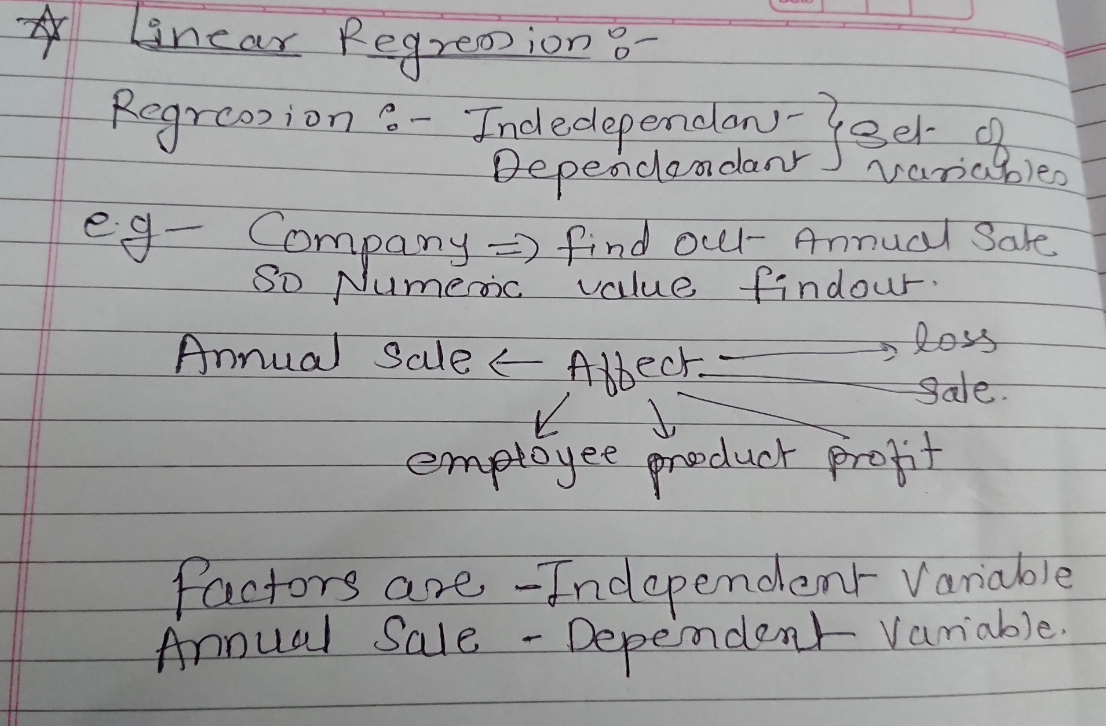

Slide 11
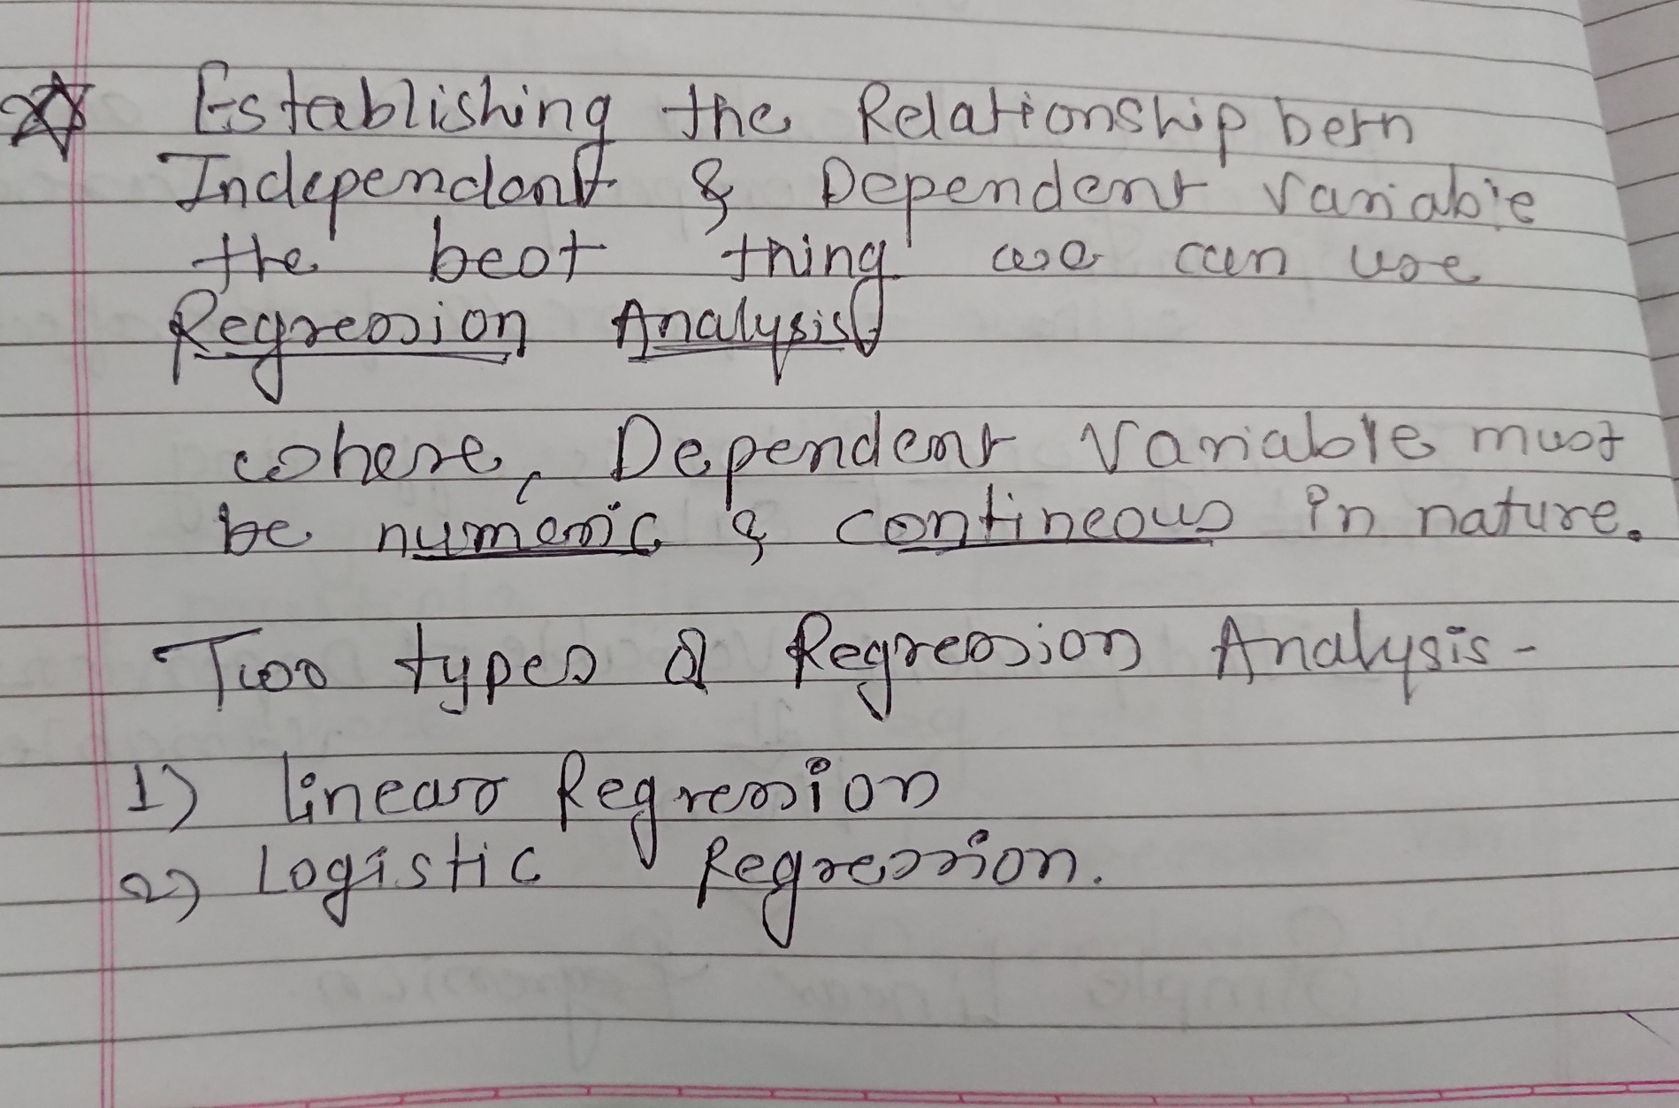

Slide 12
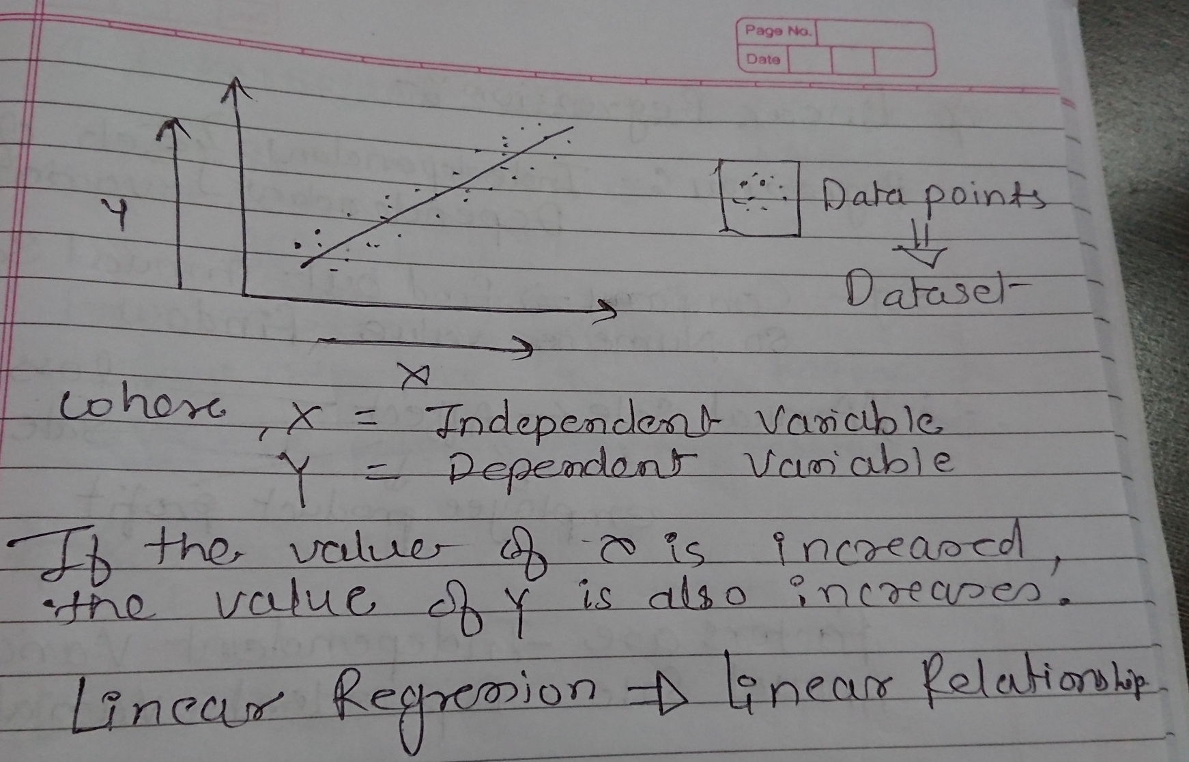
Linear Regression

Slide 13
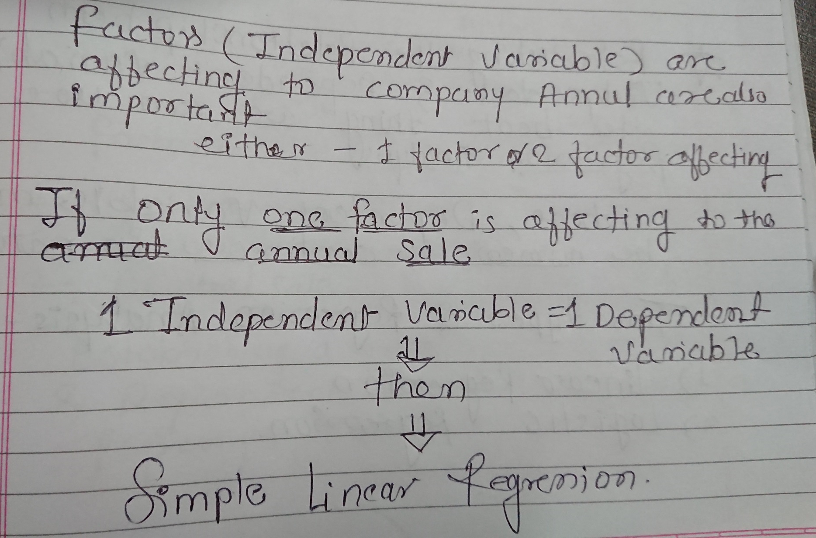

Slide 14
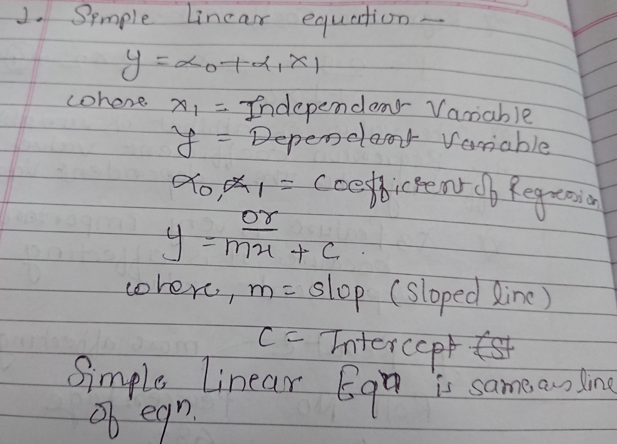

Slide 15
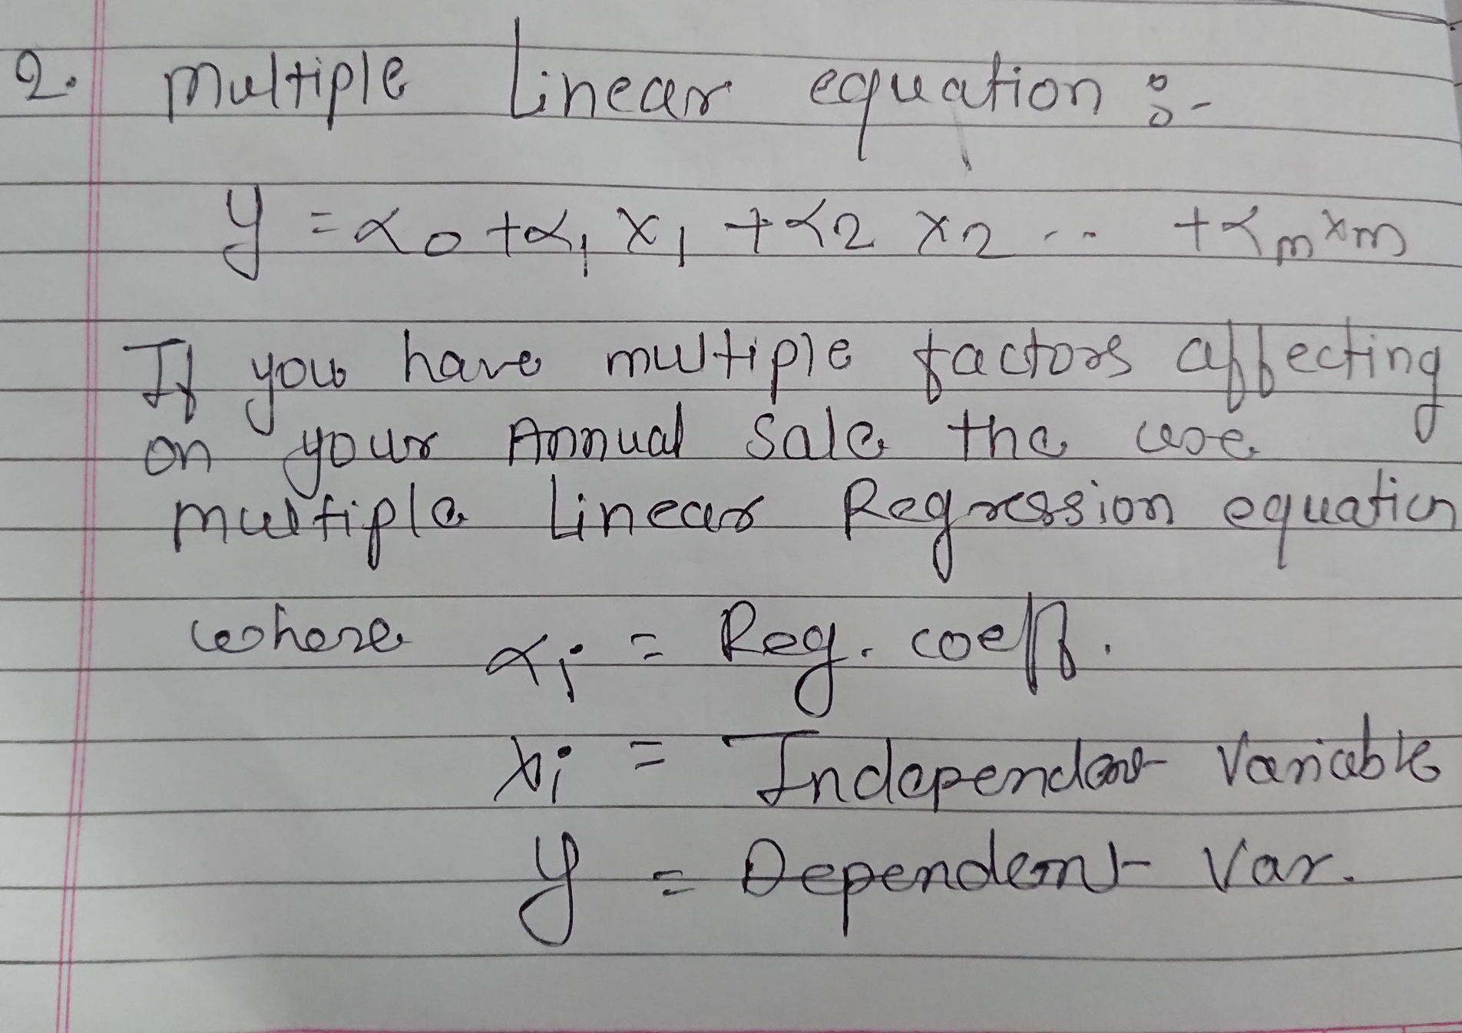

Slide 16
